Slide 1
YANG & NetConf

Slide 2
What is a Network Management Protocol?
• Remote primitives to view and manipulate the data
• Encoding of the data as defined by the data model
NETCONF:
The Network Configuration Protocol (NETCONF) provides mechanisms to install, manipulate, and delete the configuration of network devices.
NETCONF provides the fundamental programming features for comfortable and robust automation of network services

Slide 3
NETCONF – A Protocol to Manipulate Configuration
Distinction between configuration and state data.
Multiple configuration data stores (candidate, running, startup)
Configuration change validations
Configuration change transactions
Selective data retrieval with filtering
Streaming and playback of event notifications
Extensible remote procedure call mechanism

Slide 4
What is a Data-Model?
A data-model explicitly and precisely determines the structure, syntax and semantics of the data.
Consistent and complete
YANG:
YANG is a data modelling language used to model configuration and state data manipulated by the Network Configuration Protocol (NETCONF), NETCONF remote procedure calls, and NETCONF notifications.

Slide 5
YANG – A Data Modeling Language for Networking
Human readable, and easy to learn representation
Hierarchical configuration data models
Reusable types and groupings (structured types)
Extensibility through augmentation mechanisms
Supports definition of operations (RPCs)
Formal constraints for configuration validation
Data modularity through modules and sub-modules
Well defined versioning rules

Slide 6
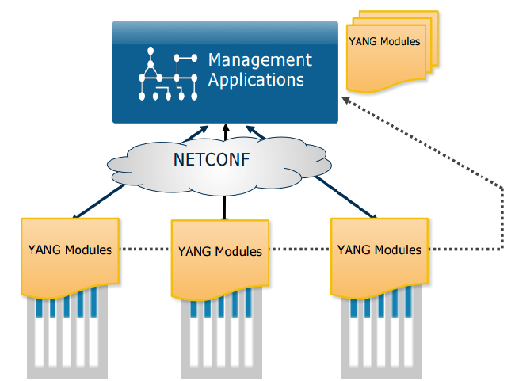

NETCONF and YANG

Slide 7
NETCONF Features
API to configure network devices
XML RPC mechanism
Connection-oriented (SSH)
Closely mirrors the device functionality
Capability Discovery
Separation of configuration and state data
Sub-tree filtering

Slide 8
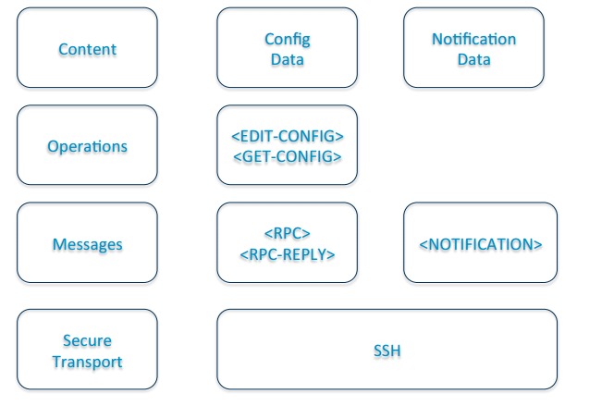
NetConf Layers

Slide 9
Common Operations
Data Manipulation
• <get>
• <get-config>
• <edit-config>
• <copy-config>
• <delete-config>
• <discard-changes> (:candidate)
Session Management
• <close-session>
• <kill-session>
Locking
• <lock>
• <unlock>
Transaction Management
• <commit> (:candidate, :confirmed)
• <cancel-commit> (:confirmed)
Schema Management
• <get-schema> (:monitoring)
RPC Extensions
• <rpc>

Slide 10
Example: NETCONF <get> Operation
<rpc message-id="101” xmlns=”urn:ietf:param
<get>
<filter type="subtree">
<top xmlns="http://example.com/ns/dhc
<interfaces>
<interface>
<ifName>eth0</ifName>
</interface>
</interfaces>
</top>
</filter>
</get>

Slide 11
YANG
Data modelling language
• Configuration data
• State data
Tree structure
Close to device
Managing device features
Data and Types
Constraints
Reusable structures
Extensions
XML
NETCONF Transport Encoding
YANG – XML Model mapping

Slide 12
Data Modeling Nodes
Leaf
Leaf-List
Container
List

Slide 13
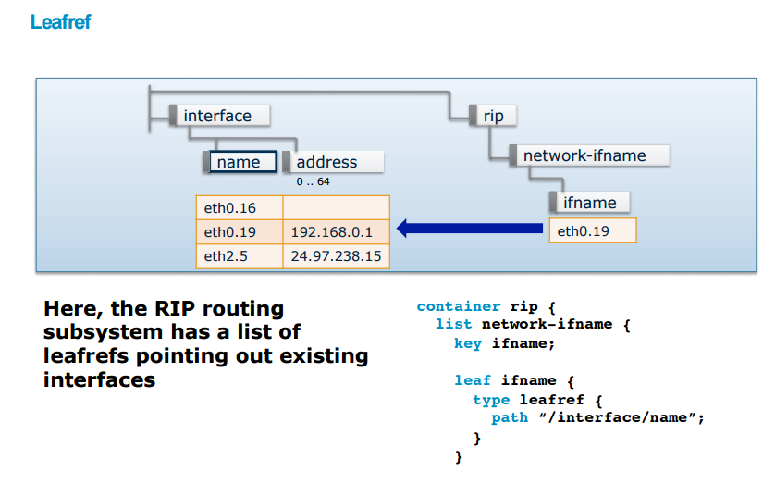

Slide 14
Thank You
www.velankani.com
NOV 2014

